Slide 1
DECISION TREE LEARNING
By Team : Thursday

Slide 2
What is Classification?
It is the process of dividing the dataset into different categories or group by adding labels.

Slide 3
USE
Emails
Fraud Transactions
Classifying the objects (like Fruits)

Slide 4
Types
Decision Tree
Random Forest
Naïve Bayes
KNN

Slide 5

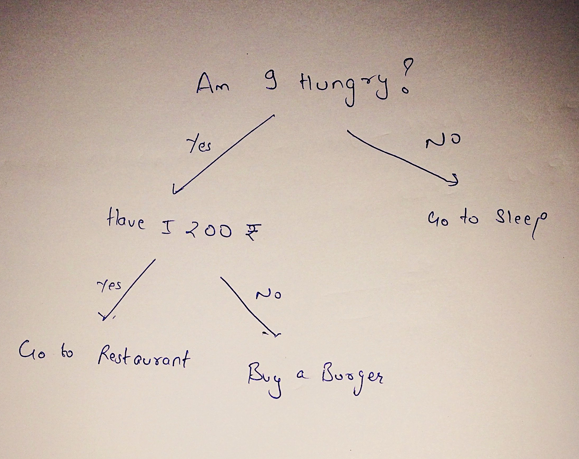
Decision Tree
It is nothing it just a Graphical Representation of all the possible solutions to a decision.Decisions are based on some conditions.

Slide 6
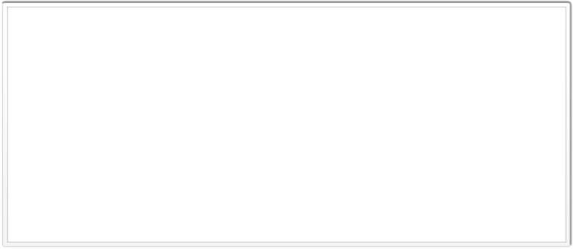

Real time example can be explained as while we call to any service provider and the system will ask set of questions using a decision tree to get you to the right person.

Slide 7
In order to build a tree we will use a Decision Tree Algorithm called CART.
CART Algorithm, stands for Classification and Regression Tree Algorithm.

Slide 8
Video: https://youtu.be/gkse-G7Uvzg

Slide 9
THANK YOU.

